Slide 1
Student Residence
Prince Lubisi
Mashilo Mahlatsi
Siyabonga Mlambo
Unarine Mukwevho
Lovedelia Maregwa
Malinga Langelihle

Slide 2
Introduction
Aim:
Explanation from the management perspective
Explanation from the student’s perspective

Slide 3
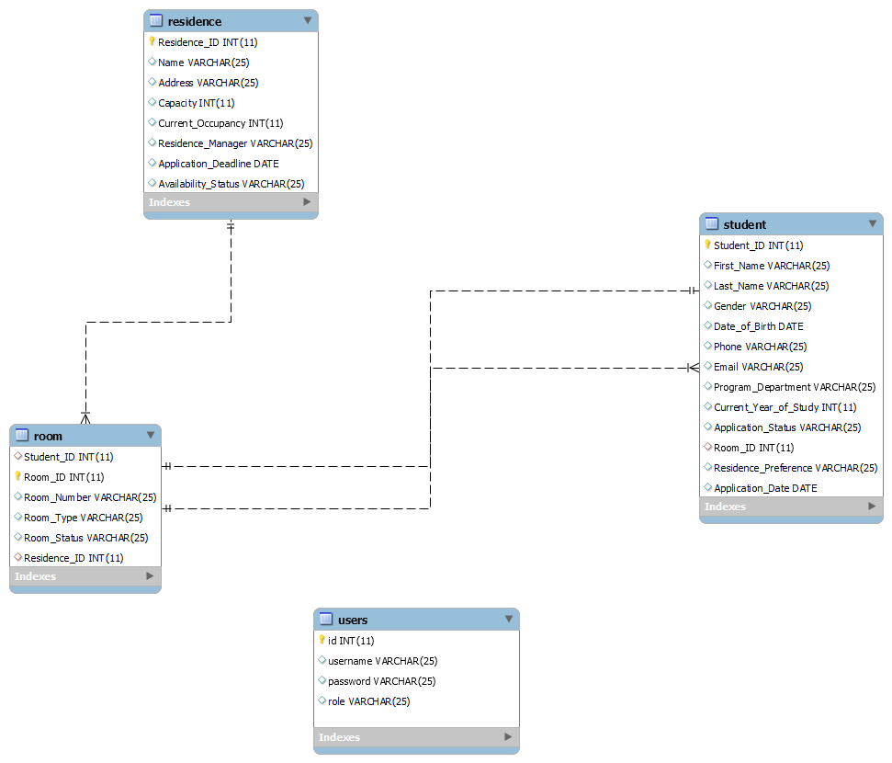
ERD Diagram

Slide 4
Normalization
Database normalization is a process used to organize a relational database efficiently.
The goal of normalization is to eliminate redundancy and dependency by organizing data into related tables.
The normalization process involves several normal forms (1NF, 2NF, 3NF), each addressing specific issues related to data redundancy and dependency

Slide 5
Normalization: Observations
residence Table:
It stores information about student residences.
room Table:
It contains information about individual rooms, including room allocation.
student Table:
It contains information about students, including room allocation.
users Table:
It appears to store user information, possibly for authentication.

Slide 6
1NF
All tables seem to be in 1NF, as there are no repeating groups, and each column contains atomic values.
Normalization
2NF
All the tables seem to be in second normal form since there are no partial dependencies

Slide 7
Web Pages
PHP files | Function | Accessed by admin Or student | Embedded with HTML
index.php | The structure of the web page Web title | both | yes
admin.php | Users with admin role Admin dashboard | admin | yes
Manager_residence | Add , delete residence | admin | yes
Manager_Rooms | Add rooms for existing residences | admin | yes
manager_applications | Managing the applications | admin | yes
View_residence.php | Display available residence details | admin | yes
rooms.php | Display student not yet allocated rooms | admin | yes
login.php | Allow you to login with username and password if (student){ direct you to studentdashboard.php} else if{admindashboard.php } else(display error message) | both | yes
PHP files | Function | Accessed by admin Or student | Embedded with HTML
register.php.php | Register to the system database | both | yes
view_applications.php | Admin approve of decline applications | admin | yes
studentdashbord.php | Retrieve student information from the database | student | yes
apply-for_residence.php | Display form for applying for residence | student | yes
error.php | Collection of error fuctions |  | no
process_applications.php | Update the application status based on admin decision to approve or dcline an application | admin | no
residence.php | Works with view-residence to display residence details | admin | yes
view-application_status.php | Direct the student to the dashboard to view application details with status | student | yes
application_success.php | Display the message for a successful applications. | student | yes
edit_rooms.php | Delete, edit room details works with manage_room.php | admin | yes
allocation-success | Display the allocated room details for a specific student | student | yes
db.php | Php that allow the connection to the database (between the front and the backend) |  | no
logout | Exist the current page and direct the user to the index.php (frontend) | Both | no

Slide 8
SQL Queries
SQL Script for joining the room table and student table:
SELECT r.Room_Number, r.Room_Type, r.Room_Status, s.First_Name, s.Last_Name, re.Name AS Residence_Name
FROM student s
LEFT JOIN room r
ON s.Room_ID = r.Room_ID
LEFT JOIN residence re
ON r.Residence_ID = re.Residence_ID
WHERE s.Student_ID = ?

Slide 9
SQL Queries
Checking if the student already has an active application
SELECT * FROM student
WHERE Student_ID = $student_id
AND Application_Status = 'Pending'

Slide 10
SQL Queries
Inserting the new residence application into the database
INSERT INTO student (Student_ID, First_Name, Last_Name, Gender, Date_Of_Birth, Phone, Email, Program_Department, Current_Year_Of_Study, Residence_Preference, Application_Status, Application_Date)
VALUES ($student_id, '$first_name', '$last_name', '$gender', '$date_of_birth', '$phone', '$email', '$program_department', '$current_year_of_study', '$residence_preference', 'Pending', '$application_date')

Slide 11
SQL Queries
Update the room details in the database
UPDATE room SET Room_Number = '$room_number', Room_Type = '$room_type', Room_Status = '$room_status', Residence_ID = '$residence_id’
WHERE Room_ID = $room_id

Slide 12
SQL Queries
Fetch the number of students in the residence
SELECT COUNT(*) AS student_count FROM room WHERE Residence_ID = $residence_id

Slide 13
Now let’s look at the website

